Slide 1


Pressure Ulcer Injury in Unstructured Clinical Notes: Detection and Interpretation
Authors: Mani Sotoodeh, MS, Zelalem H. Gero, MS, Wenhui Zhang, PhD, MS, RN, Roy L. Simpson, DNP, RN, Vicki Stover Hertzberg, PhD, Joyce C. Ho, PhD
S49 - Care Management
Presenter : Mani Sotoodeh
Institution : Emory University
Twitter: @SotoodehMani
#AMIA2020

Slide 2

Disclosure & Acknowledgement
The authors and their spouse/partner have no relevant relationships with commercial interests to disclose.
This work was supported by NIH grant 1R01LM013323; PIs: V. Hertzberg, Joyce Ho, Roy Simpson.

Slide 3
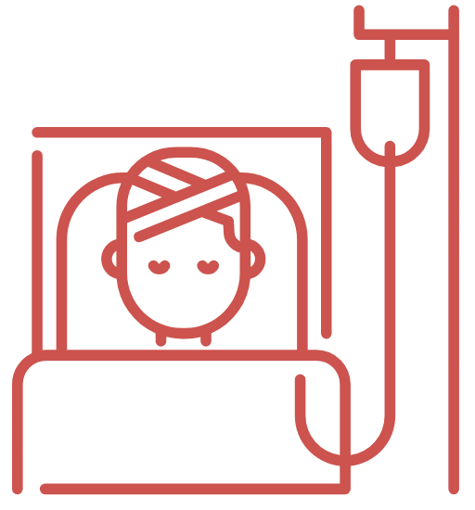

PUI Detection & Prediction: a necessary task
Over 2.5 million Americans develop PUI each year
Hospital readmissions due to PUI are 75% higher
Reduced quality of life, higher mortality, longer hospital stays
Penalties to the bottom 25% of hospitals as a nursing quality metric
Allocate resources better esp. for intensive and postoperative care units
Notes:
and healthcare quality
more institutionalization after hospitalization, and economic burdens
such as specialized pressure mattresses
and nurses to monitor skin status,
A primary nursing quality metric a key indicator for patient safety
has many disadvantages. High cost, subjectivity, substantial disagreement among nurses
highly variable sensitivity and specificity, poor prognostic accuracy,no apparent impact on decreasing PUI incidence.
rather than predicting PUI development within a prospective time interval
nursing notes can contain changes in patient vital signs,
and is also interpretable in a general
symptoms, and care and thus offer more predictive power for PUI detection compared to structured data
leveraged for
PUI prediction prior to its occurrence for early detection, to inform nurses to implement appropriate interventions in, sense, i.e. we can pinpoint specific keywords that play the most important role in the occurrence of PUI for specific institutions

Slide 4
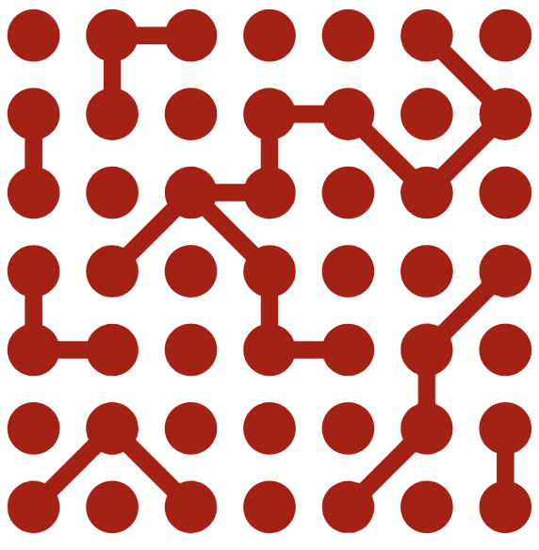
Manual assessment is inefficient→ Automation
Existing challenges in PUI assessment and PUI detection literature
Quarterly assessments of one hospital in a single day has many problems
Missed opportunities to change practices leading to inadequate care
Inefficiency of risk assessment tools such as the Braden scale
Most works are on identifying risk factors retrospectively
Nurse-collected data is not actively mined for patient information
Contributions
Exploratory analysis of unstructured data (notes) for PUI detection
Automated PUI detection enables more frequent assessments
Notes:
has many disadvantages. High cost, subjectivity, substantial disagreement among nurses
highly variable sensitivity and specificity, poor prognostic accuracy,no apparent impact on decreasing PUI incidence.
rather than predicting PUI development within a prospective time interval
nursing notes can contain changes in patient vital signs,
and is also interpretable in a general
symptoms, and care and thus offer more predictive power for PUI detection compared to structured data
leveraged for
PUI prediction prior to its occurrence for early detection, to inform nurses to implement appropriate interventions in, sense, i.e. we can pinpoint specific keywords that play the most important role in the occurrence of PUI for specific institutions

Slide 5
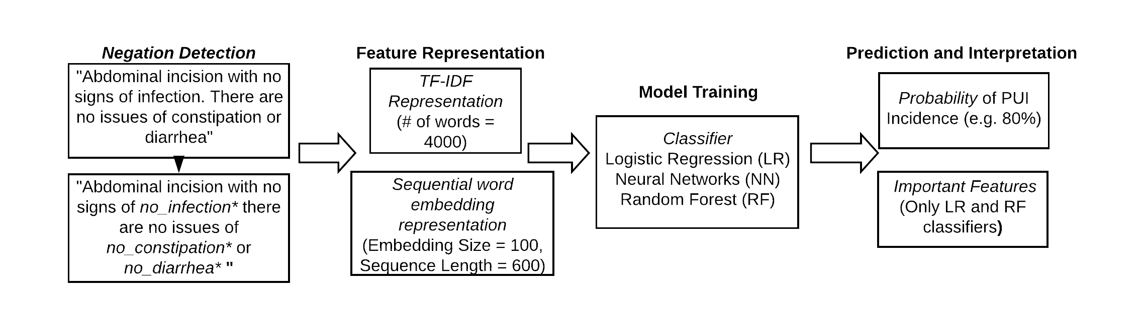
Overall framework: PUI detection from notes
Notes:
This is an overview of the general framework of PUI detection from notes
We first transform the notes for each sample by identifying negative mentions of disease and conditions and replacing them by their negative counter parts.
We then construct features from the transformed notes for our machine learning problem using two methods, tf-idf represntation and sequential word embedding
Next, we train three classifiers on these features, that are logistic regression NN and Random forest.
And finally we get the probability of pui incidence . Furthermore we can look at the relative performance of classifiers in PUI detection and closely analyze at the significant keywords contribuing the most if possible.

Slide 6
Negation detection using NER and Regex
Spacy: Extracting all mentions of named entities including disease, medication, symptoms, and chemicals
NegEX
Employs defined regular expressions indicating negation
Limits the scope of the negation phrase
Filters out phrases that falsely appear to be negation phrases
“showed no evidence of congestive heart failure or pneumonia”
“showed evidence of no congestive heart failure or no pneumonia”
Notes:
For the first phase, negation detection for notes, we employ two consecutive steps,
we first use a tool called spacy to extract all mentions of named entities like diseases, medical conditions and chemicals
In the next step, we use another tool, NegEX, which uses regular exprssions to identify negation patterns in text, and limit their scope by setting boundaries around them. It also filters out sentences that only seem to be negative, but really indicate presence of the condition. For instance, withine passage , here , no evidence imply
This negation detection and using a negation aware version of notes instead of the original to construct features, enable the classifer to more readily adopt these negated expression for its prediction, shoule they be important

Slide 7

Feature construction and Baseline models
Text Vector representations
TF-IDF representation
Sequential Word Embedding Representation
Baseline models
Logistic Regression
Random Forest
Neural Networks
Data Split
68% training, 12% validation & 20% test, 30 runs
Notes:
To construct our features, we use two different representations widely used in natural language processing applications, ..
we used the most common 4000 words in the whole corupus of notes and their frequencies as features
a sequence of 600 words for each document, and an embedding size of a 100 to repreent each word in the featuer space.
we chose these three representative baseliens beacue:
Logistic Regression: Simple,interpretable and intuitive
Random Forest: Less interpretability for better performance
Neural Networks: Least interpretable, most complex
For LR and RF, we use tf, idf representaiton, since using a sequence model we use sequential word embedding
for each experimental configuration, we split data into ... and we repeat each experiment 30 times to ensure generelizabily
our PUI detection task can attain better performance at the expense of losing some interpretability.
For LR, Using the learned weights, as indicators of feature importance. By sorting the weights in descending order
we report the feature importance that is calculated. In contrast to LR however, we only know the relative importance

Slide 8
MIMIC III dataset , Problem setup
Open data, 49K hospital admissions, stays of people younger than 20 are removed
PUI-positive from an ICD-9 perspective
[707, 707.1, 707.2, 707.3, 707.4, 707.5, 707.6, 707.7, 707.9, 707.11, 707.21, 707.22, 707.23, 707.24, 707.25]
PUI-positive from a notes perspective
[Pressure Ulcer Prevention, Skin Surveillance, Decubitus Ulcers, Impaired Tissue Integrity, Impaird Skin integrity, Bed Sores, Pressure Ulcer, Pressure sore]
Stays indicating PUI in both (neither) sources constitute → + (-) class
Each + sample is matched with 4 - ones closest to it in age, gender, length of stay
Total number of samples: 3,589 Positive samples: 856 (23.8%)
Notes:
We used MIMIC iii, an openly available dataset, that has 49k hostpital stays.
Samples: individual hospital stays, Features: Concatenated notes of each stay. we establish the label for each stay by looking at its ICD9 codes and the keywords used in its notes. if any of the icd9 codes in this list is found, that stay is positive for PUI from an iCD9 perspective. We used a case-cotrol design , after that,
Hospital-stays indicating PUI in both (neither) sources constitute → + (-) class
from 38k unique adults
very few positive cases of PUI were present in the younger population,
since shorter stays provide insufficient notes for satisfactory representation, and
extremely long stays are most probably erroneous records in this specific dataset.
, closest to it in terms of age, gender, the total length of stay and ICU length of stay.

Slide 9
Results: Negation Detection boosts prediction
Classifier | Average Test AUC (SD) |  | Average Test F1 (SD)
 | Negation-Aware | w/o Negation Detection | Negation-Aware | w/o Negation Detection
Neural Networks (NN) | 0.8462 (0.0169) | 0.8440 (0.0161) | 0.6252 (0.0291) | 0.6189 (0.0302)
Logistic Regression (LR)* | 0.9022 (0.0120) | 0.8720 (0.0155) | 0.6905 (0.0188) | 0.6455 (0.0248)
Random Forest (RF) | 0.9533 (0.0086) | 0.9530 (0.0071) | 0.7887 (0.0226) | 0.7862 (0.0219)
Notes:
Here you can see the performance of the three classifiers, in terms of AUC and F1score, with and without negation detection. First we can observe that Random forest performs the best, followed by Logistic regression and NN with performs the worst.
We observe the greatest benefit in using negation detection for logistic regression classifiers. Similarly, negation detection improves the performance of Neural Networks and randome forest too.
Average AUC and F1 score and a one-sided paired t-test
improvements in all three classifiers
NN: performs the worst, likely due to over-fitting
PUI’s low incidence rate + with privacy concerns for data collaboration across hospitals LR (and occasionally RF)
Since RF performs random subsampling for each tree, these minority negative words are even less likely to be included in individual trees.
for each classifier to determine whether the improvement had a p-value below 0.05

Slide 10
Results : Words created by negation detection contribute greatly to classification
Classifier | Found only in | Indicating PUI’s | Words in the Set (importance)
LR | Negation-aware notes | Absence | mso (-0.3182), groundglass (-0.2953), swanganz (-0.2915), preoperative (-0.2730), no_ectopy (-0.2632), no_edema (-0.2560), independent (-0.2531), no_sob (-0.2137), no_pneumothorax (-0.2107), number (-0.1918), no_pulmonary (-0.1881)
LR | Untouched notes | Absence | ganz (-0.3563 ), mso4 (-0.3431), lat (-0.3431 ), ward (-0.2286), lima (-0.1443), hyperthermia (-0.1169), pepcid (-0.1156), neoplasm (-0.1043), Sao2 (-0.1023), pyrexia (-0.1006)
RF | Negation-aware notes | Presence or Absence | no_wound (0.0016), apply (0.0011), multipodus (0.0011), swanganz (0.0008), sch (0.0005), clip (0.0004), [no_skin, no_pneumothorax, unit, no_infection] (all 0.0003)
RF | Untouched notes | Presence or Absence | lat (0.0007 ), ptitle (0.0006), ganz (0.0005), name (0.0004), [followup, numeric, lastname, identifier] (all 0.0003), fi02, defined] (all 0.0002)
Notes:
Here we compare the 10 most significant words in LR and RF classifiers using negation-aware and untouched notes. We can extract the significant words for LR, using the learned weight, and for RF, using the count and level of splits made on a feature across all trees.
First notice that, among the 10 most important words indicating - class: 5 and 4 words are the direct result of Negation detection.
Also, Words from the negation-aware version have comparatively higher weights, than their untouched notes counterparts, showing thier higher contriubituion.
Finally, Some words in the 10 most contibuing words for the untouched notess are just non-specic general descriptors. These all show
no PUI in LR and RF, are the direct product of negation detection step, proving its utility than their untouched notes counterparts
some of the words appearing in the top 10 for the model trained on untouched notes are solely non-specific general descriptors, which is rare in negation-aware versions (e.g. all words inRF untouched notes case except “ganx” and “fio2” are non-specific)

Slide 11
Results: Prominent features (words) overlap with medical literature on PUI
Classifier | Type of Words (or notes) | Indicating PUI’s | Most Medically Meaningful Keywords in the Set (importance)
LR | Only no_ .... words | Presence | no_wound (0.2951), no_erythema (0.2303), no_skin (0.1629), no_infection (0.1420), no_obstruction (0.1403), no_ct (0.1291), no_secretions (0.0850), no_lesions (0.0728)
LR | Only no_ .... words | Absence | no_edema (-0.2560 ), no_stool (-0.1241), no_pain (-0.0923 ), no_diuresis (-0.0744), no_hemorrhage (-0.0677), no_bleed (-0.0589), no_bleeding (-0.0523)
LR | Only Negation-aware | Absence | swanganz (-0.2915 ), no_edema (-0.2560), independent (-0.2531 ), pacu (-0.1765), bloodtinged (-0.1314), no_stool (-0.1241)
RF | Only no_ .... words | Presence or Absence | no_wound (0.0016), [no_skin, no_tube] (0.0003), [no_infection, no_blood, no_insulin, no_erythema, no_hypotension] (all 0.0002), [no_diuresis, no_abscess, no_pain, no_stool, no_edema, no_gtt] (all 0.0001)
RF | Only Negation-aware | Presence or Absence | no_wound (0.0016 ), multipodus (0.0010), [no_skin , no_infection , no_tube, no_insulin] (all 0.0003), sedate (0.0002)
Notes:
Here we look into how closely words only discovered using negation-aware notes, and the negated words themselves overlap with medical literature on PUI.
No erythema : consistent with the updated definition of “Stage 1 Pressure Injury: Non-blanchable erythema of intact skin”.1
swangaz and no tube indicate PUI related medical devices
sedate or PACU (post anesthesia care unit) are related to special care units where PUI happens more oftehn
Braden risk :no secretions, no stool, independent; no obstruction & multipodus
Diuresis : recently identified predictive features for PUI in ICU
and finally in terms of the risky comorbidities we have by no insulin),indidcating diabetes glycemic control and no hypotension and no infection

Slide 12

Using notes is promising, possible next steps
Findings of the current work
Detection of PUI for quality assurance purposes using notes of the care team
Negation Detection improves models’ predictive performance
Most contributing keywords have considerable overlap with medical literature
Potential extensions and directions
Further improvement by hyperparameter tuning & more complex models
ConText, an extension for more accurate identification of medical terms
Predict PUI prior to its occurrence and detecting its stage
Notes:
In conclusion, we showed how notes from the care team can be used for automatic PUI detection
We also showed through our experiments the utily of negation detection step for predictive performance and having a more interpretable model.
Finally we showed that the keywords used the most by classifiers have considerable overlap with medical literature
in the clinical setting
and improving care by timely interventions though
, is a critically valuable tool in nursing care
and utilizing
of the tool we used
ConText
where effective nursing and medical
interventions might prevent PUI emergence,
a topic of high interest among clinicians.2

Slide 13
Thank you!
Email me at: msotood@emory.edu

Slide 14
Problem Setup
Unit of analysis: hospital stays
Features: Available notes for each stay, concatenated into a single document
Hospital-stays indicating PUI in both (neither) sources constitute → + (-) class
Each + sample is matched with 4 negative samples (stays), closest to it in terms of age, gender, the total length of stay and ICU length of stay.
Cohort | Total # of Unique stays | # of PUI stays | # of no PUI stays
MIMIC-III total hospital-stays | 50,027 | 1,249 (2.4%) | 46,227 (92%)
Target age and length of stay cases | 26,838 | 856 (3.1%) | 23,886 (89%)
Case controlled stays | 3,589 | 856 (23.8%) | 2,733 (76.2%)
Notes:
f any of the explicit PUI keywords in Definition 2 or string
versions of ICD-9 codes in Definition 1 appears in the notes
856 positive stays, 2733 negative stays, 2733 negative stays
final cohort :3589 hospital samples, 31.3% positive to negative sample ratio.

Slide 15
Results: Comparison of Classifiers and significant keywords
NN: performs the worst, likely due to over-fitting
PUI’s low incidence rate + with privacy concerns for data collaboration across hospitals LR (and occasionally RF)
Among the 10 most important words indicating - class: 5 and 4 negated words
Words from the negation-aware version have comparatively higher weights
Some words in the top 10 for the untouched notes are general descriptors
Notes:
NN is not easily interpretable
. This is as NN has an exponential number of parameters
uggests that the predictive model should be robust even
when trained on a smaller number of data samples

